Slide 1
Chapter 11
How to debug an application

Slide 2
Objectives
Applied
Use the debugging techniques presented in this chapter to debug any unhandled exceptions or logical errors in the applications that you develop.
Knowledge
Describe the differences between the three Step commands that you can use to control the execution of an application.
Describe the primary differences between the Autos window, the Locals window, and the Watch window.
Describe the use of the Immediate window.
Describe the call stack that’s displayed in the Call Stack window.
Explain how you can use the Debug class to display information in the Output window.

Slide 3
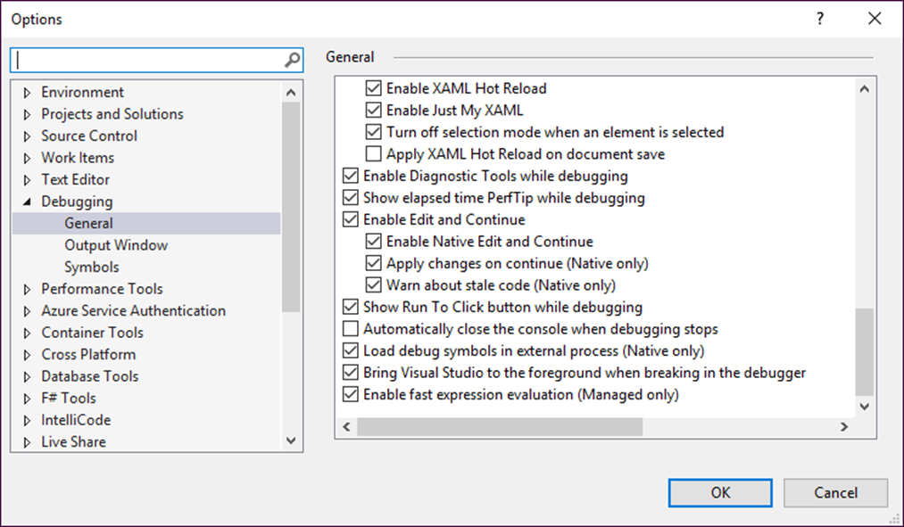
The Options dialog box

Slide 4
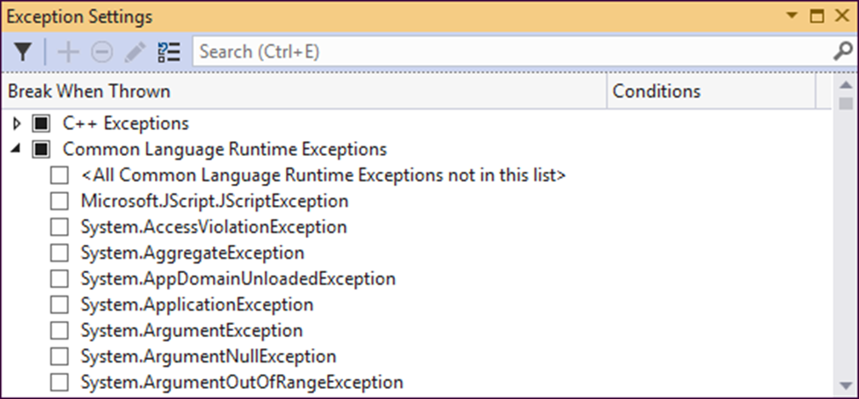
The Exception Settings window

Slide 5
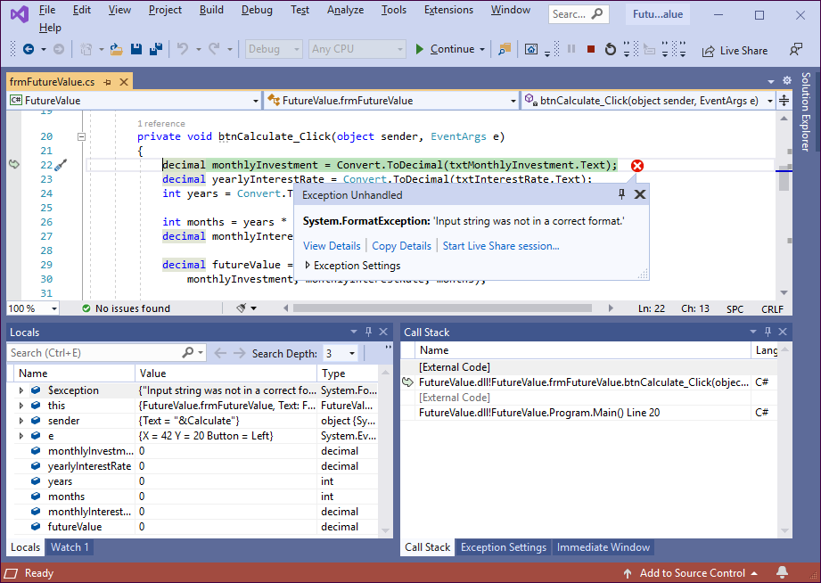
The Future Value application in break mode

Slide 6
Four ways to enter break mode
Force an unhandled exception to be thrown.
Set a breakpoint and run the application.
Choose the Debug→Step Into command or press F11 to begin debugging at the first line of the application.
Choose the Debug→Break All command or press Ctrl+Alt+Break while the application is executing.

Slide 7
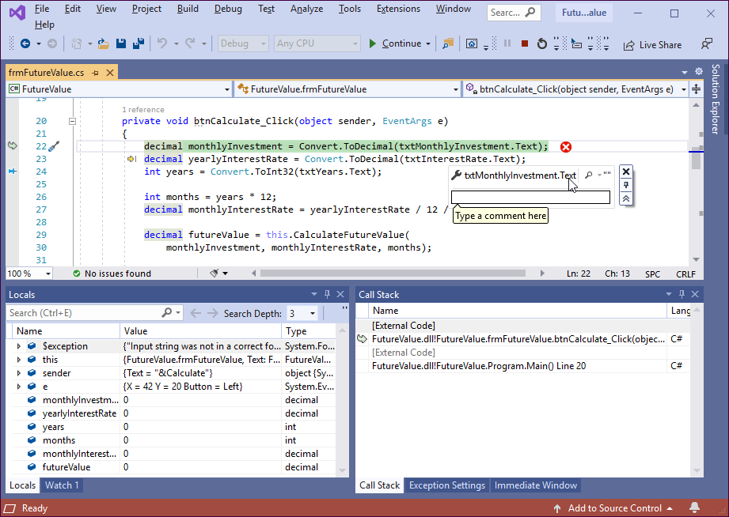
The Future Value application with a data tip displayed

Slide 8
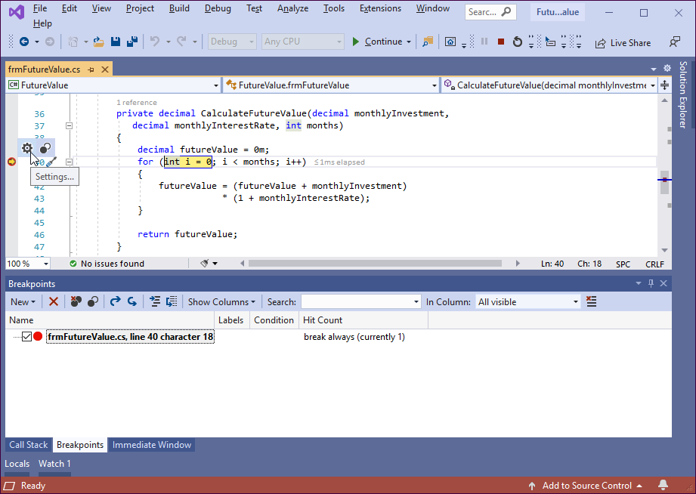
The Future Value application with a breakpoint

Slide 9
How to set and clear breakpoints
To set a breakpoint, click or tap in the margin indicator bar to the left of a statement. Or, press the F9 key to set a breakpoint at the insertion point.
You can set a breakpoint before you run an application or while the application is in break mode.
To remove a breakpoint, use any of the techniques for setting a breakpoint. To remove all breakpoints at once, use the Debug→Delete All Breakpoints command.
To disable all breakpoints, use the Debug→Disable All Breakpoints command. To enable all breakpoints, use the Debug→Enable All Breakpoints command.

Slide 10
Commands in the Debug menu and toolbar

Slide 11
Commands in the Code Editor’s shortcut menu
Command Description
Run to Cursor Execute the application until it reaches the statement that contains the insertion point.
Set Next Statement Set the statement that contains the insertion point as the next statement to be executed.

Slide 12
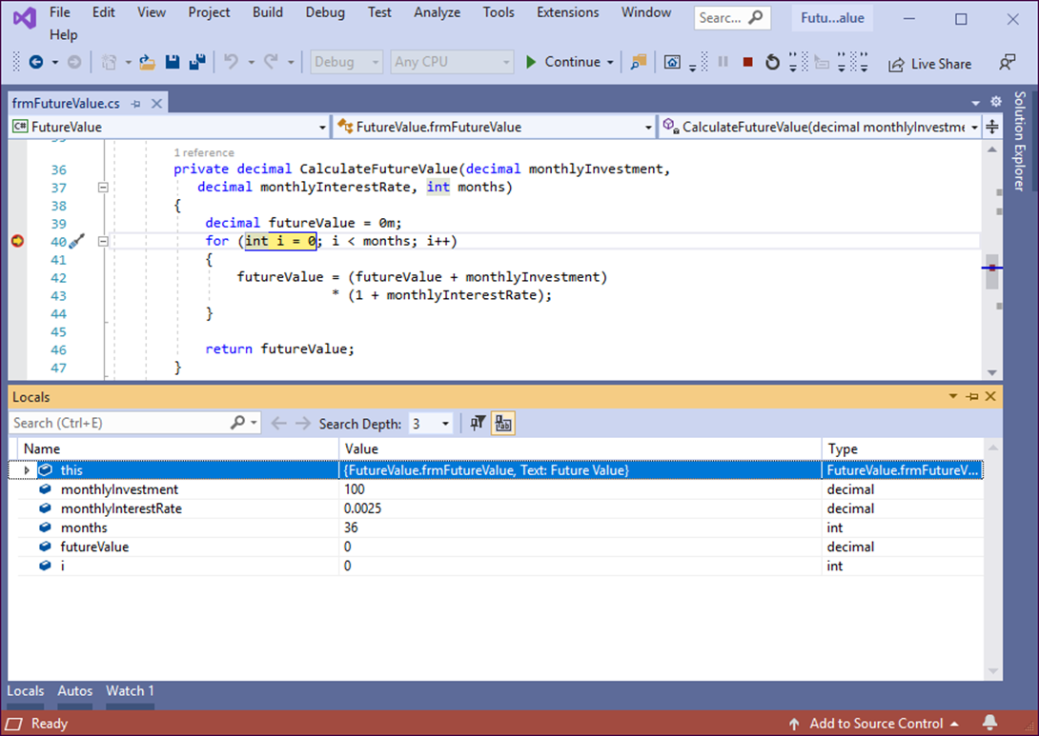
The Locals window

Slide 13
How to use the Locals window
The Locals window displays information about the variables within the current scope.
To display the Locals window, click on the Locals tab or use the Debug→Windows→Locals command.
If you are debugging a form and you click on the  symbol to the left of the this keyword, the properties and variables of the form are displayed. You can pin a property to the top of this group by hovering the mouse over the property and clicking the pin icon that appears to the right of the property name.
To change the value of a property or variable, double-click on the value in the Value column, then type a new value and press the Enter key.

Slide 14
How to use the Autos window
The Autos window works like the Locals window, but it only displays information about variables used by the current statement and the previous statement.
To display the Autos window, you can use the Debug→Windows→Autos command.

Slide 15
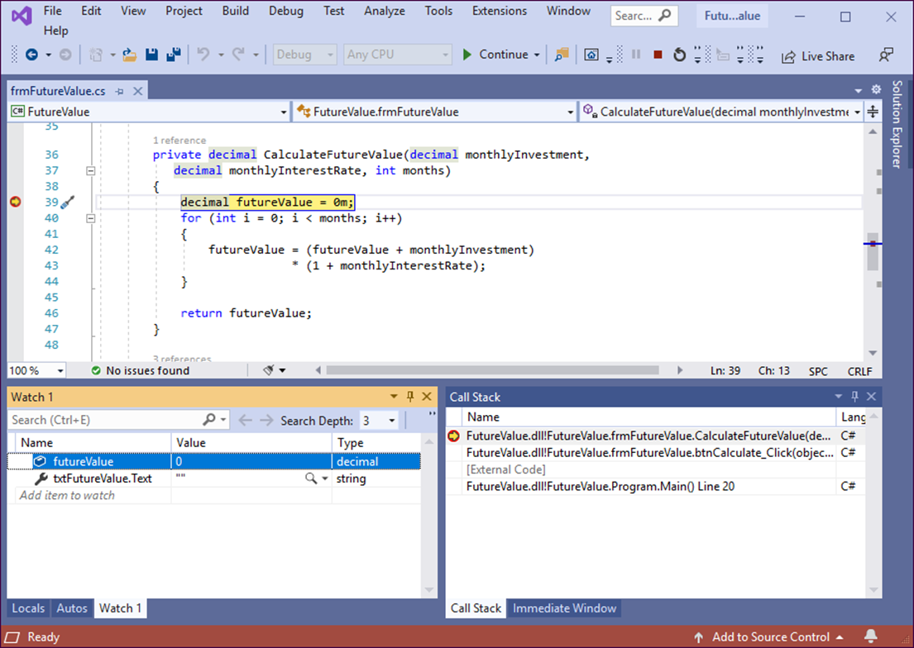
A Watch window

Slide 16
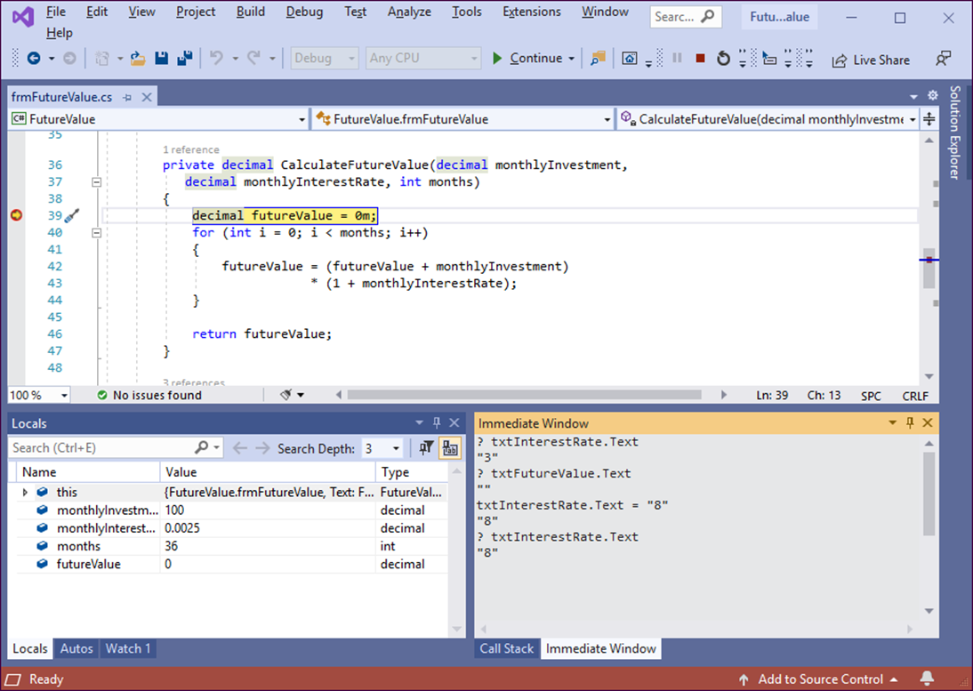
The Immediate window

Slide 17
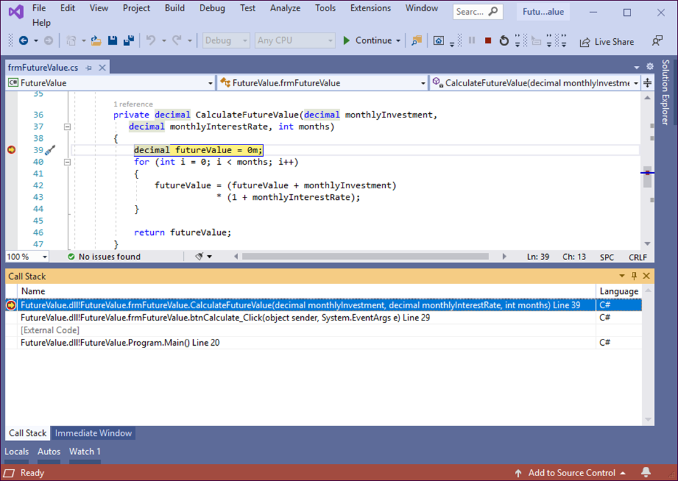
The Call Stack window

Slide 18
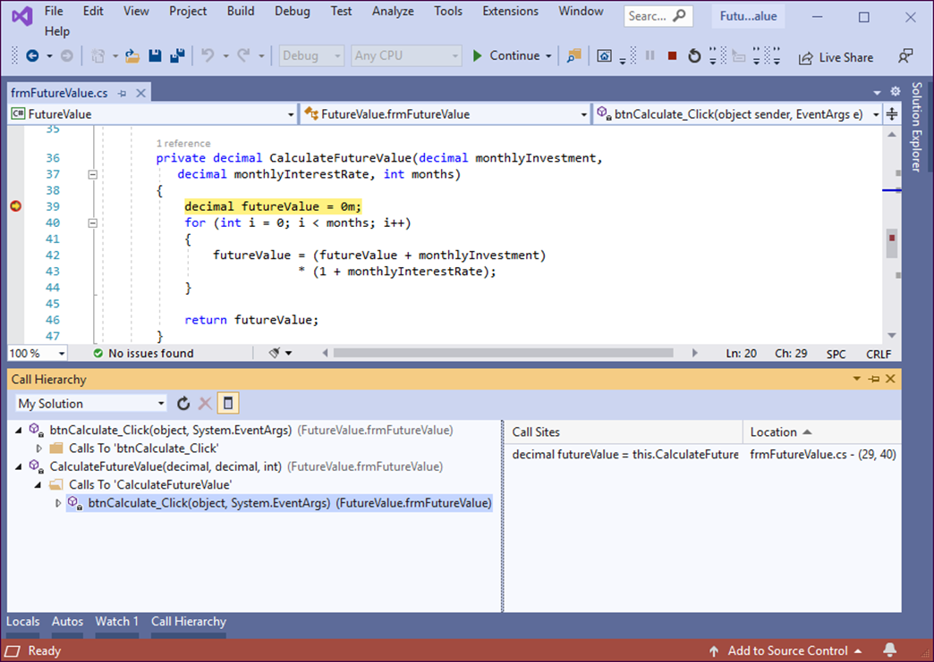
The Call Hierarchy window with two methods displayed

Slide 19
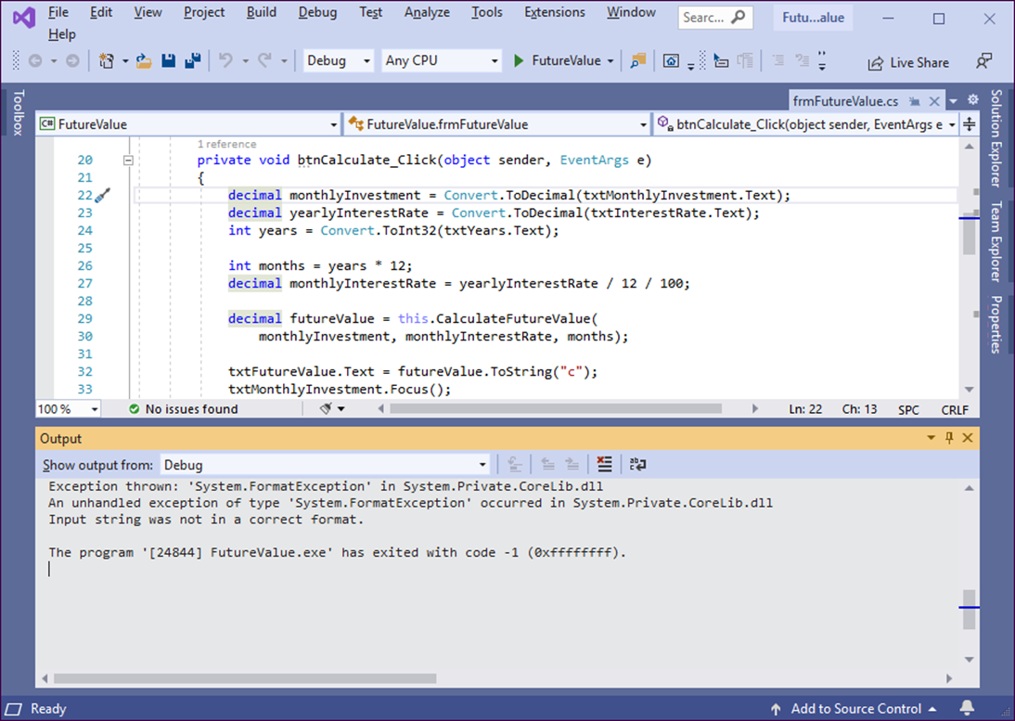
An Output window that shows debug information

Slide 20
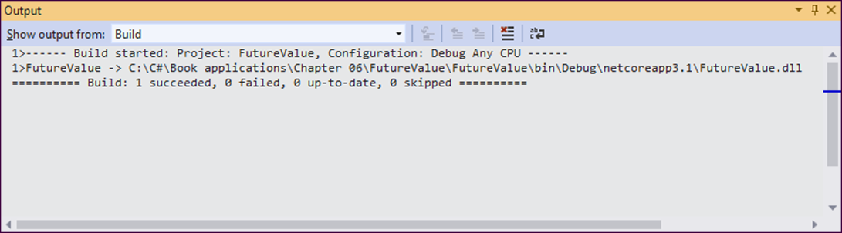
An Output window that shows build information

Slide 21
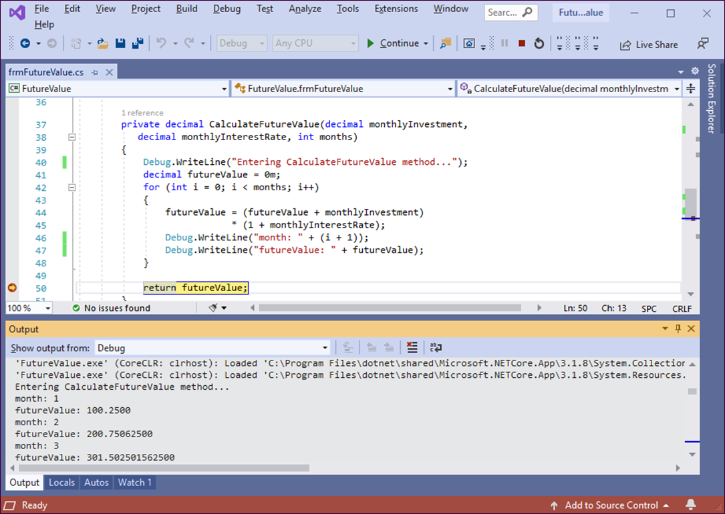
An Output window with debugging information

Slide 22
Methods of the Debug class that write data to the Output window
Write(string)
WriteLine(string)
A using statement for the namespace that contains the Debug class
using System.Diagnostics;

Slide 23
Three statements that write data to the Output window
Debug.WriteLine("Entering CalculateFutureValue method...");
Debug.WriteLine("month: " + (i+1));
Debug.WriteLine("futureValue: " + futureValue);
Code that uses an if statement to control when data is written
if ((i+1)%12 == 0) // every 12 months
Debug.WriteLine("futureValue: " + futureValue);

Slide 24
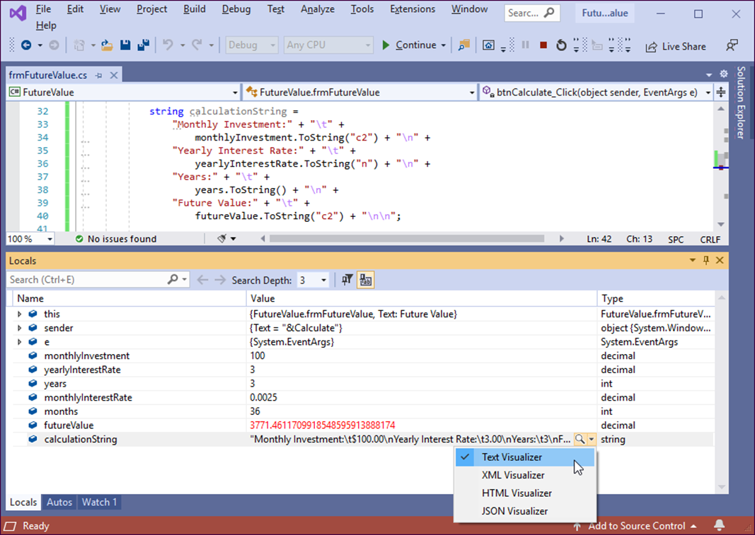
The Visualizer menu in the Locals window

Slide 25
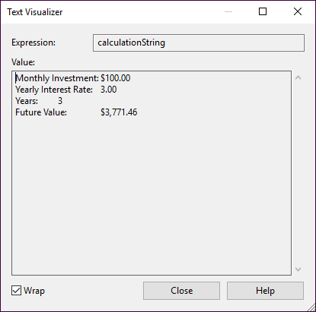
The Text Visualizer dialog box

Slide 26
Objectives
Applied
Use the debugging techniques presented in this chapter to debug any unhandled exceptions or logical errors in the applications that you develop.
Knowledge
Describe the differences between the three Step commands that you can use to control the execution of an application.
Describe the primary differences between the Autos window, the Locals window, and the Watch window.
Describe the use of the Immediate window.
Describe the call stack that’s displayed in the Call Stack window.
Explain how you can use the Debug class to display information in the Output window.

